Slide 1

The 4.8 Change on China
Cross-Border eCommerce
Jeff Song
APPharma Pty Ltd

Slide 2
Export to China – Available Channels
Traditional international trade
  Complicated processes (e.g. customs, quarantine, etc.) , prolonged clearance
  High import taxes (import duties, value-added tax and consumption tax), could go up to 150% (e.g. health supplements 20-40%)
  Restricted entry requirements for healthcare & personal care products such as health supplements, cosmetics, etc. (e.g. CFDA registrations, compliance checking, Chinese labelling, etc.)
Daigou
  People based in overseas buying goods and sending them back to China as personal items
  No tax up to certain amounts (Not commercial!)
  No product registration , compliance checking and labelling requirements
Cross-Border eCommerce
  Direct import of goods from outside the customs territory of China, utilising special pilot channels, known as cross-border e-commerce platforms, and based on the preferential policies of bonded zones in selected cities.
  Reduced import taxes. Health supplement 0-10%. Tax is not charged if it’s RMB 50 or lower.
  No product registration, compliance checking and labelling requirements
  Simplified processes, quick clearance and dispatch
APPharma Pty Ltd

Slide 3
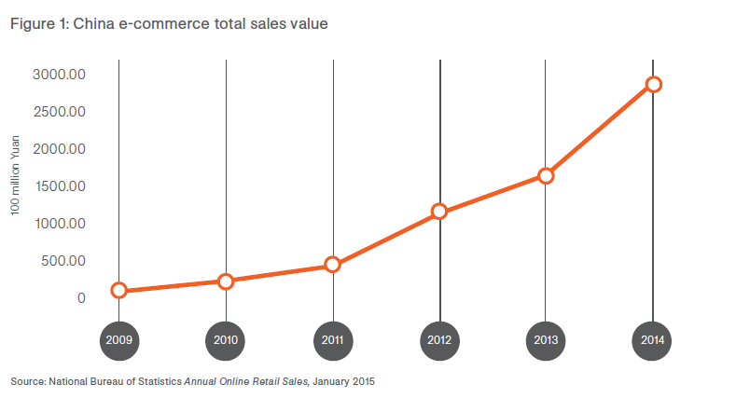
It’s predicted that imported eCommerce products in 2016 will worth RMB 6.5 trillion, and it will soon account for 20% of China’s foreign trade.
China eCommerce Sales
APPharma Pty Ltd

Slide 4
Cross-Border eCommerce Sales
Direct to customers
  Customers order goods online in China via online shops (e.g. Tmall, Taobao, JD, VIP, etc.), overseas suppliers ship goods to the customers via international postal or courier
  Small quantities
  Direct to retail customers
Bonded warehouse
  Goods in large quantities as consolidated shipment were sent to licensed eCommerce trading platform company bonded warehouses in free trade zones in China via sea or air freight
  Large quantities
  Orders are cleared and processed by the licensed eCommerce trading platforms , then dispatched to retail customers from the bonded warehouses
  The licensed eCommerce trading platform companies have their own online shops or offline shops in the free trade zones, they also work together with other online companies such as Tmall or JD as partners for product sales
APPharma Pty Ltd

Slide 5
4.8 Changes on Cross-Boarder eCommerce
Introduced by the Ministry of Finance, General Administration of Customs and the State Administration of Taxation
Effective from the 8th of April, 2016
Three main areas of changes
  Taxes
  Allowable goods
  Other conditions (e.g. product registrations)
APPharma Pty Ltd

Slide 6
Taxes
Previous
  Treated as personal postal articles with a ‘parcel tax’
  Low tax rate (0-10% for health supplements)
  Tax under RMB 50 is waived
Now
  Multiple taxes: subject to import duties, value-added tax and consumption tax (~ 11.9% for health supplements)
  Limits: at this tax rate, max single transaction of product value up to RBM 2,000, annual value up to RMB 20,000. Importation over these limits will be charged with conventional import tax rate
APPharma Pty Ltd

Slide 7
Allowable Goods
Previous
  All goods can go through cross-border eCommerce channel
Now
  Cross-border eCommerce retail import commodity lists (Part 1 and 2)
  Only goods on the lists are allowed to be imported via this channel
  Not many complementary medicines are on the lists
APPharma Pty Ltd

Slide 8
Other Conditions
Previous
  Complementary medicines (health supplements) and cosmetics are allowed to be imported as is without product registrations with CFDA
Now
  First time imported products are required to be registered with CFDA
APPharma Pty Ltd

Slide 9
What Happened After 4.8
Confusion, frustration, worries……
Significant negative impacts to the businesses in Australia and China (estimated 30-50% down)
Operations in China
  Existing goods in bonded warehouses have been processed with the new taxes, most likely not applied with the CFDA registration and other requirements
  Perhaps no one is dare to make new orders at the moment, as most likely the new orders will be applied with the new requirements such as CFDA product registrations
APPharma Pty Ltd

Slide 10
The Latest Development
The tax part of the 4.8 change is to be continually implemented
News that the 4.8 changes (non-tax parts) will be postponed for 12 months. I could not confirm the truth of the news at this stage
APPharma Pty Ltd

Slide 11
The Future
It’s expected there are some modifications of the policies to soften them a bit to ensure the businesses are not penalised/damaged so deeply and so suddenly
Rumours there are new policies on the way (do not quote me on this one!)
This one is confirmed true – the CFDA will implement a new ‘recording’ (or ‘filing’) registration system from the 1st of July 2016, in parallel with the current ‘registration’ system (blue hat). This new express system will help the cross-border eCommerce when product registrations are required:
  Simplified requirements
  Shorter timeframe
  Lower costs
  First applied to 22 single vitamin and mineral products
APPharma Pty Ltd

Slide 12

Questions
Email: jeff.song@appharma.com.au
Phone: 0401 091 878
Web: www.appharma.com.au
www.appaharma.cn
APPharma Pty Ltd

